Slide 1

Diabetes Severity Prediction System
Rohith Reddy Peddi
Sai Srinivas Puranam
Bhuvanendra Putchala
Sai Gowtham Dasappa Ravindra

Slide 2

Agenda :
Introduction
Data Description
Data Pipeline
Data Pre-Processing
EDA
Modeling and Tuning
Results
Conclusions
Limitations and Future work
References

Slide 3

Introduction
Millions face the threat of diabetes, but early detection can save lives.
The project aims to develop a highly accurate model for early detection to reduce the disease's impact on individuals and healthcare systems.
It employs ML for early diabetes prediction by analyzing health data and identifying patterns.
It explores intricate relationships between health factors and diabetes for improved patient care.
The findings are intended to pave the way for proactive diabetes management and a healthier future.

Slide 4

Data Description
Data is gathered from Center for Disease Control and Prevention (CDC.gov), a survey based on Behavioral Risk Factor Surveillance System .
Overall data has 445K rows and 327 columns . These columns are basically survey based questions related to various health conditions.
We selected our data to be comprised of 445K rows and 30 columns which are found to be relevant for our analysis and modelling.

Slide 5
Data Pipeline
Data
Preparation
Data
Analysis
Raw Data
01
03
Model Evaluation
and Prediction
Hyper
parameter
Tuning
02
Feature
Selection

Slide 6
Data Pre-Processing
1. Understanding Data Structure:
Thoroughly examined the dataset codebook, since there were only survey based questions and responses but not any data points, to acquire a thorough grasp of the format, meaning, and potential limits of each data point before moving on to cleaning and transformation.
2. Imputation of Missing Values:
Utilizing the mean and median values, filled in the missing numerical values for columns.
In place of missing category data, we used context-specific labels such as "not_applicable" or "not_sure".
3. Managing Outliers:
Identified and addressed outliers using techniques like capping for “sleeping_time” column.

Slide 7
Data Pre-Processing
4. Data Encoding:
For consistency, we converted numerical features (ex: height and weight columns) to the appropriate standard units.
Transformed categorical attributes into analytically-useful numerical values.
5. Feature Engineering:
Developed new features from preexisting ones in order to get more data or enhance the functionality of the model.
Applied standardisation techniques to the numerical columns

Slide 8
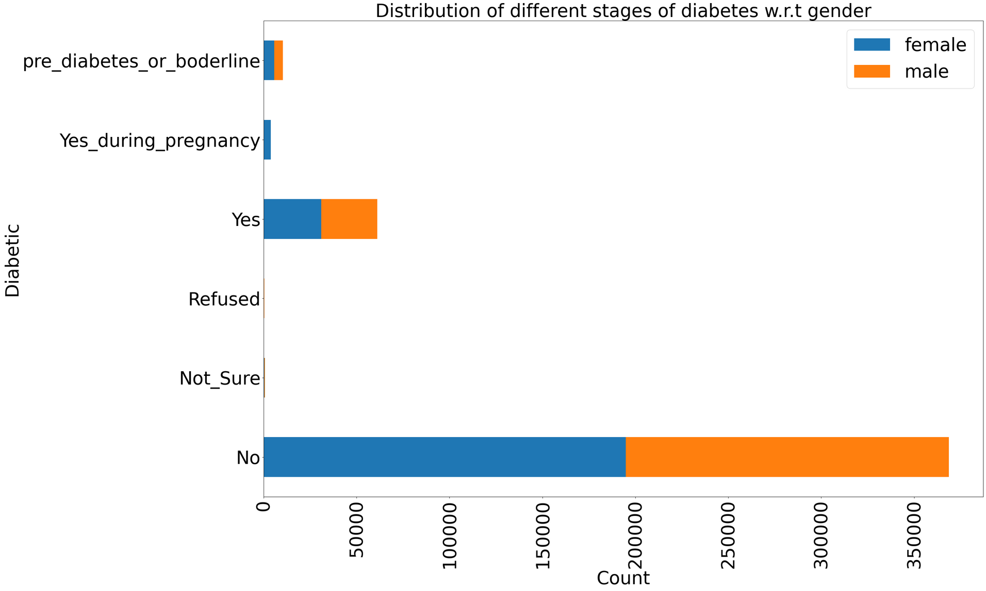
Exploratory Data Analysis (EDA)
The data distribution of diabetes stages on gender-wise
reveals an equal distribution of "Yes" and "No" categories for both genders, suggesting no significant gender bias in diabetes prevalence.

Slide 9
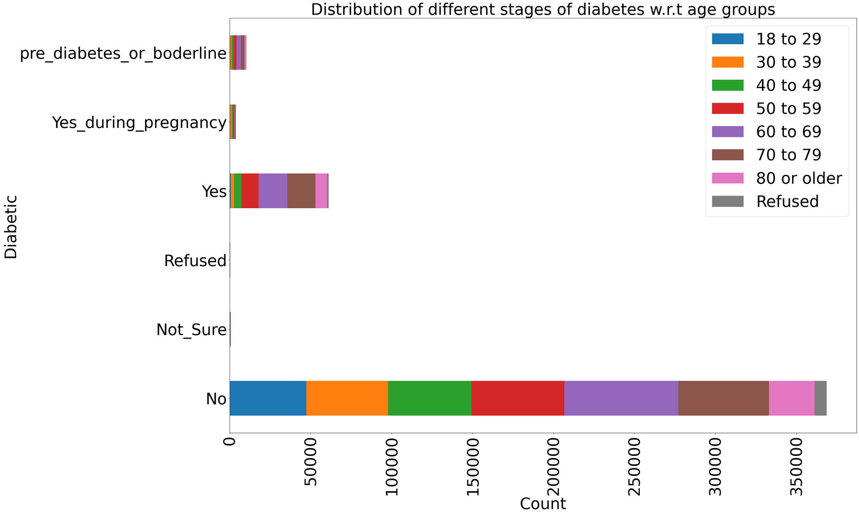
Exploratory Data Analysis (EDA)
Our analysis shows a clear trend towards higher diabetes rates in individuals over 60, highlighting the importance of early prevention and proactive healthcare in older populations.

Slide 10
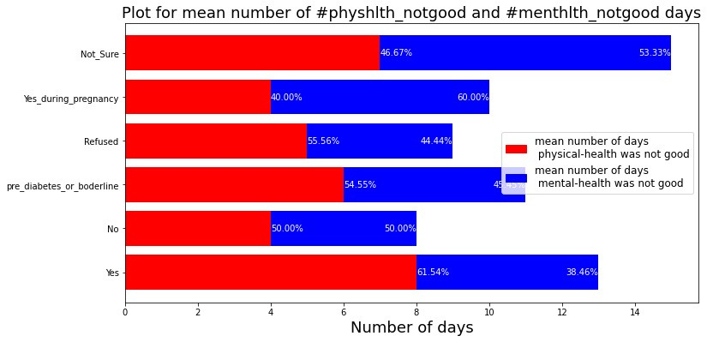
Exploratory Data Analysis (EDA)
Our study suggests poorer physical health, compared to mental health, plays a more significant role in diabetic conditions, highlighting the importance of managing physical well-being for diabetic patients.

Slide 11
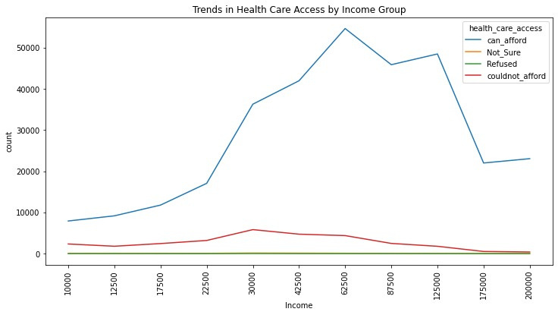
Exploratory Data Analysis (EDA)
Our analysis revealed a surprising trend in healthcare access. It was highest for those in the middle income brackets, highlighting potential challenges for both low and high earners.

Slide 12
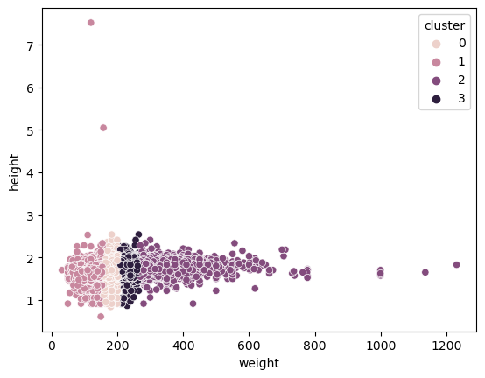
Clustering (K-Means)
Performed kmeans clustering to look at the similarities
in the data. clusters are separated on one axis that indicates there's is a high correlation.
some of the points that are away from custers might be the outliers.

Slide 13
Hypothesis Testing
Hypothesis 1:
H0: No significant difference in average sleep duration between individuals with and without diabetes.
H1: Individuals with diabetes have a significantly different average sleep duration compared to those without diabetes.
Result:
The ANOVA test resulted a p-value greater than 0.05, indicating that the null hypothesis was not rejected. This suggests that there is no significant difference in average sleep duration between individuals with and without diabetes.
Hypothesis 2:
H0: There is no significant association between having diabetes and reporting a certain number of mentally unhealthy days.
H1: The number of mentally unhealthy days is significantly different between individuals with and without diabetes.
Result:
The ANOVA test resulted a p-value less than 0.05, indicating that the null hypothesis was rejected. This suggests that The number of mentally unhealthy days is significantly different between individuals with and without diabetes.

Slide 14
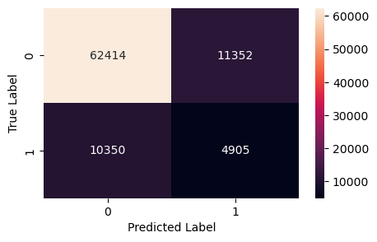
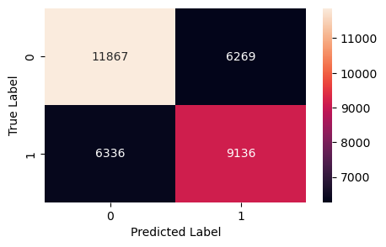
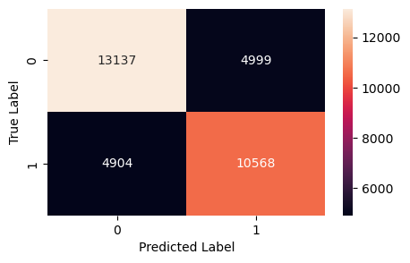
Modeling - Decision Tree
Class Imbalance Handling:
Identified class imbalance in the selected data. To handle it, we have utilized under-sampling technique.
Pre Sampling
Post Sampling
Post Hyper-Parameter Tuning
Accuracy - 75.62%
F1 Score - 31.13%
Precision - 30.17%
Recall - 32.25%
Accuracy - 62.49%
F1 Score - 59.18%
Precision - 59.35%
Recall - 59.05%
Accuracy - 70.53%
F1 Score - 68.09%
Precision - 67.89%
Recall - 68.30%

Slide 15
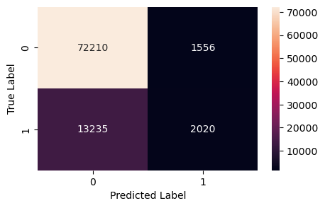

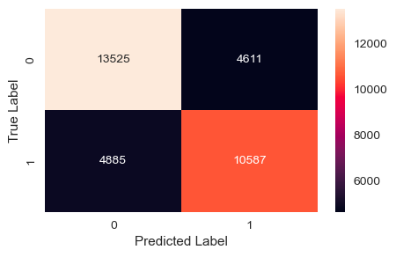
Modeling - Logistic Regression
Pre Sampling
Post Sampling
Post Hyper-parameter tuning
Accuracy - 83.38%%
F1 Score - 21.45%
Precision -56.49%
Recall - 13.24%
Accuracy - 71.80%
F1 Score - 69.12%
Precision - 69.69%
Recall - 68.56%
Accuracy - 71.74%
F1 Score - 69.04%
Precision - 69.66%
Recall - 68.43%

Slide 16

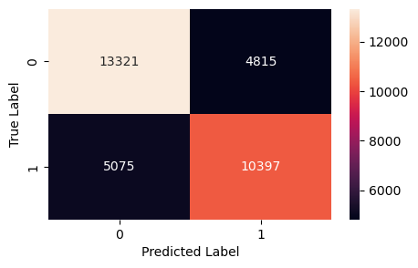

Modeling - Random Forest
Pre Sampling
Post Sampling
Post Hyper-Parameter Tuning
Accuracy - 82.80%
F1 Score - 20.88%
Precision - 50.10%
Recall - 13.19%
Accuracy - 70.76%
F1 Score - 68.34%
Precision - 68.13%
Recall - 68.55%
Accuracy - 71.82%
F1 Score - 69.58%
Precision - 69.16%
Recall - 70.01%

Slide 17

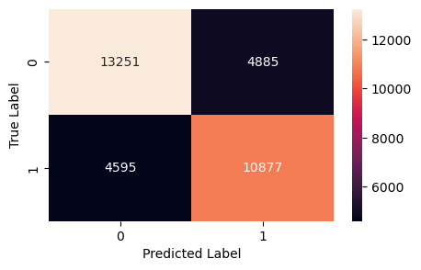

Modeling - XG Boost
Pre Sampling
Post Sampling
Post Hyper-Parameter Tuning
Accuracy - 83.48%
F1 Score - 25.41 %
Precision - 51.60%
Recall - 16.43%
Accuracy - 71.79%
F1 Score - 69.65%
Precision - 69.01%
Recall - 70.30%
Accuracy - 72.21%
F1 Score - 70.13%
Precision - 69.41%
Recall - 70.86%

Slide 18
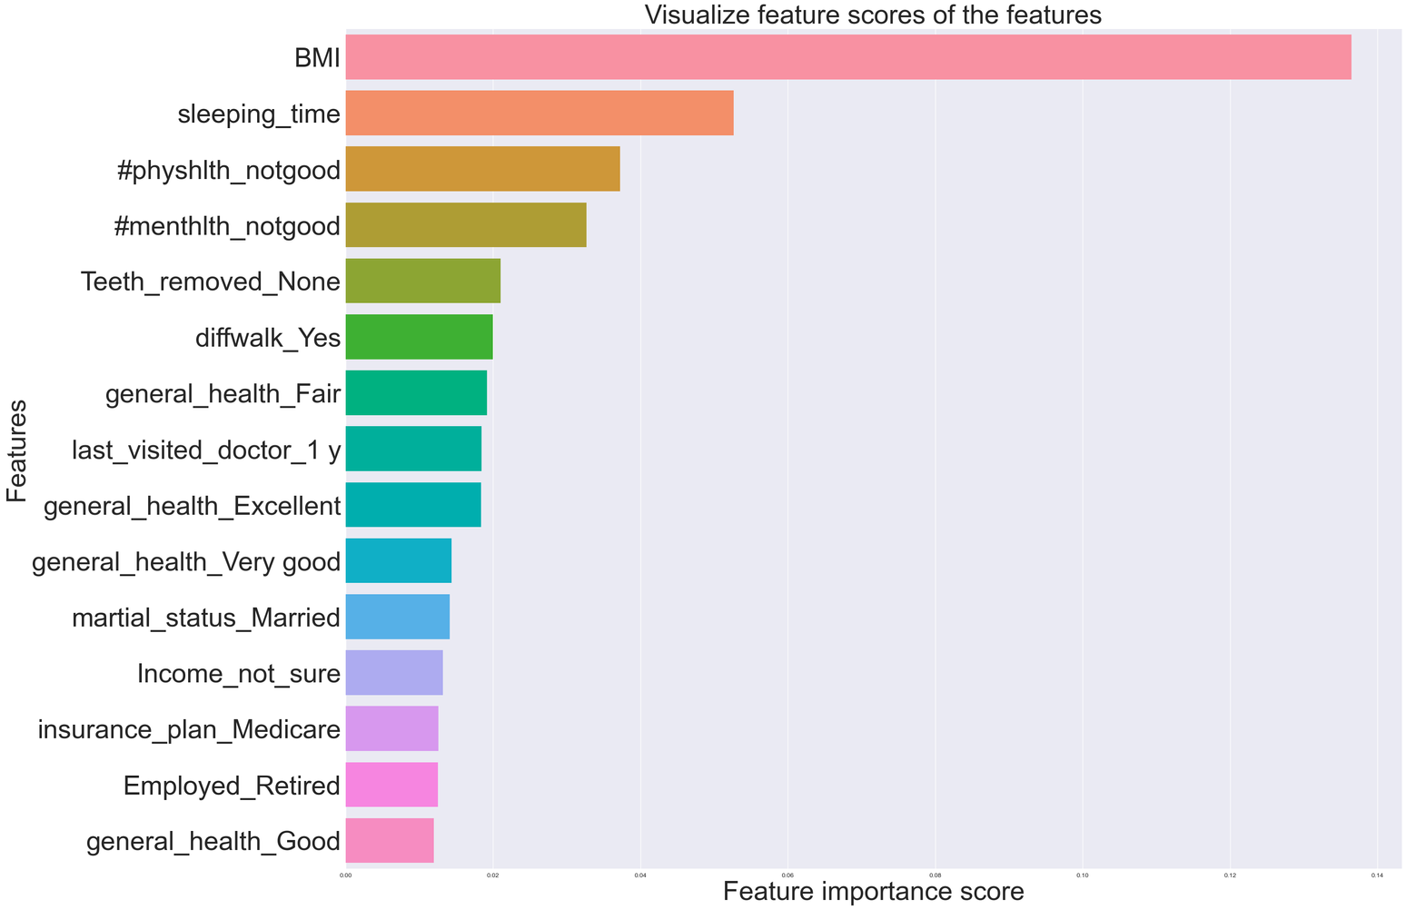
Modeling - Feature Importance Score

Slide 19
Conclusion
The project demonstrates the potential use of machine learning to achieve highly accurate early detection of diabetes, offering a powerful tool for preventing its devastating impact on individuals and healthcare systems.
Analyzing the data set from the CDC's BRFSS survey revealed intricate relationships between various health conditions and diabetes risk.
Using sophisticated techniques like XG Boost, we built a predictive model boasting an impressive accuracy of approximately 72% in early diabetes detection.
The project paves the way for proactive diabetes management strategies by empowering early detection and effective prevention, thus contributing to a healthier future for individuals at risk of diabetes and promotes a more sustainable healthcare landscape.

Slide 20
Limitations
Survey data may not always capture the full picture of health, potentially limiting model accuracy.
Addressing class imbalance in the data set (e.g., fewer diabetics than non-diabetics) could further enhance model performance.
While XG Boost showed promise, exploring other algorithms and optimizing existing models could potentially improve accuracy.
Validating the model on new data sets is crucial to ensure its generalizability and effectiveness in broader contexts.
The model solely focuses on individual health factors. Incorporating socio-economic determinants of health disparities could yield a more holistic understanding of diabetes risk.
Addressing behavioral factors beyond the survey scope (e.g., dietary habits, physical activity) might improve prediction and intervention strategies.

Slide 21
Future Scope
Gathering information on potentially relevant, currently missing data points for future analysis.
Conducting further tests with additional parameters to improve prediction accuracy and severity estimation.
Analyzing potentially overlooked risk factors like family history, smoking, metabolic syndrome, and physical activity levels.not included in the current analysis.
Leveraging potentially overlooked risk factors to build more accurate and robust prediction models.

Slide 22
References
Al‐Janabi, A., Littlewood, Z., Griffiths, C. E. M., Hunter, H. J. A., Chinoy, H., Moriarty, C., Yiu, Z. Z. N., & Warren, R. B. (2021). Antibody responses to single‐dose SARS‐CoV‐2 vaccination in patients receiving immunomodulators for immune‐mediated inflammatory disease. British Journal of Dermatology, 185(3), 646–648. https://doi.org/10.1111/bjd.20479
Aljumah, A. A., Ahamad, M. G., & Siddiqui, M. K. (2013). Application of data mining: Diabetes health care in young and old patients. Journal of King Saud University - Computer and Information Sciences, 25(2), 127–136. https://doi.org/10.1016/j.jksuci.2012.10.003
Balpande, V. R., & Wajgi, R. D. (2017). Prediction and severity estimation of diabetes using data mining technique. 2017 International Conference on Innovative Mechanisms for Industry Applications (ICIMIA), 576–580. https://doi.org/10.1109/ICIMIA.2017.7975526

Slide 23
References
Cheng, H.-Y., Jian, S.-W., Liu, D.-P., Ng, T.-C., Huang, W.-T., & Lin, H.-H. (2020). Contact Tracing Assessment of COVID-19 Transmission Dynamics in Taiwan and Risk at Different Exposure Periods Before and After Symptom Onset. JAMA Internal Medicine, 180(9), 1156. https://doi.org/10.1001/jamainternmed.2020.2020
Kibria, H. B., & Matin, A. (2022). The severity prediction of the binary and multi-class cardiovascular disease − A machine learning-based fusion approach. Computational Biology and Chemistry, 98, 107672. https://doi.org/10.1016/j.compbiolchem.2022.107672
Li, Q., Guan, X., Wu, P., Wang, X., Zhou, L., Tong, Y., Ren, R., Leung, K. S. M., Lau, E. H. Y., Wong, J. Y., Xing, X., Xiang, N., Wu, Y., Li, C., Chen, Q., Li, D., Liu, T., Zhao, J., Liu, M., … Feng, Z. (2020). Early Transmission Dynamics in Wuhan, China, of Novel Coronavirus–Infected Pneumonia. New England Journal of Medicine, 382(13), 1199–1207. https://doi.org/10.1056/NEJMoa2001316

Slide 24


